Slide 1
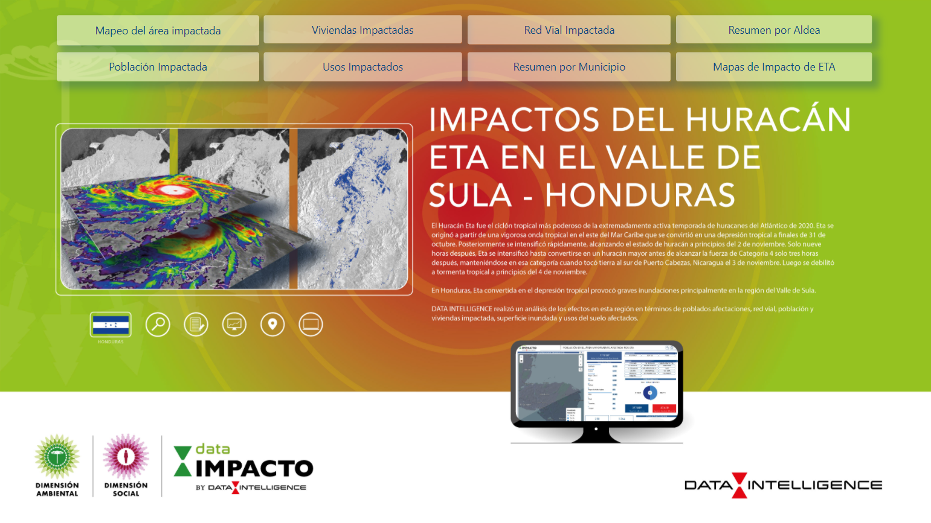
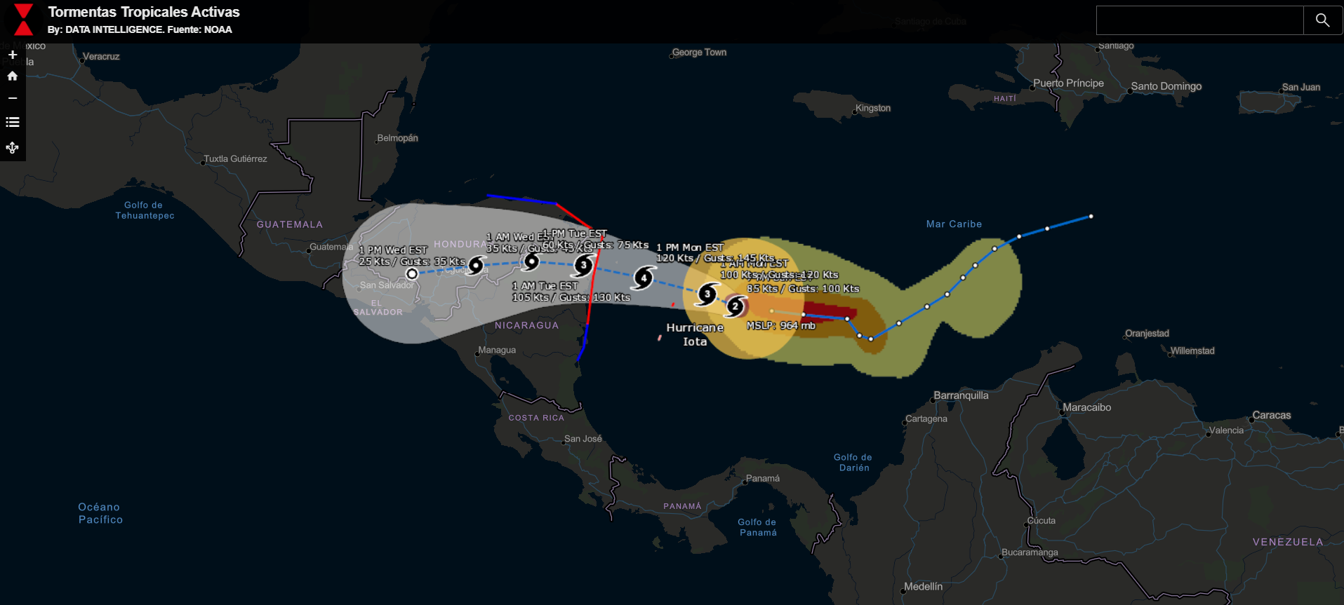
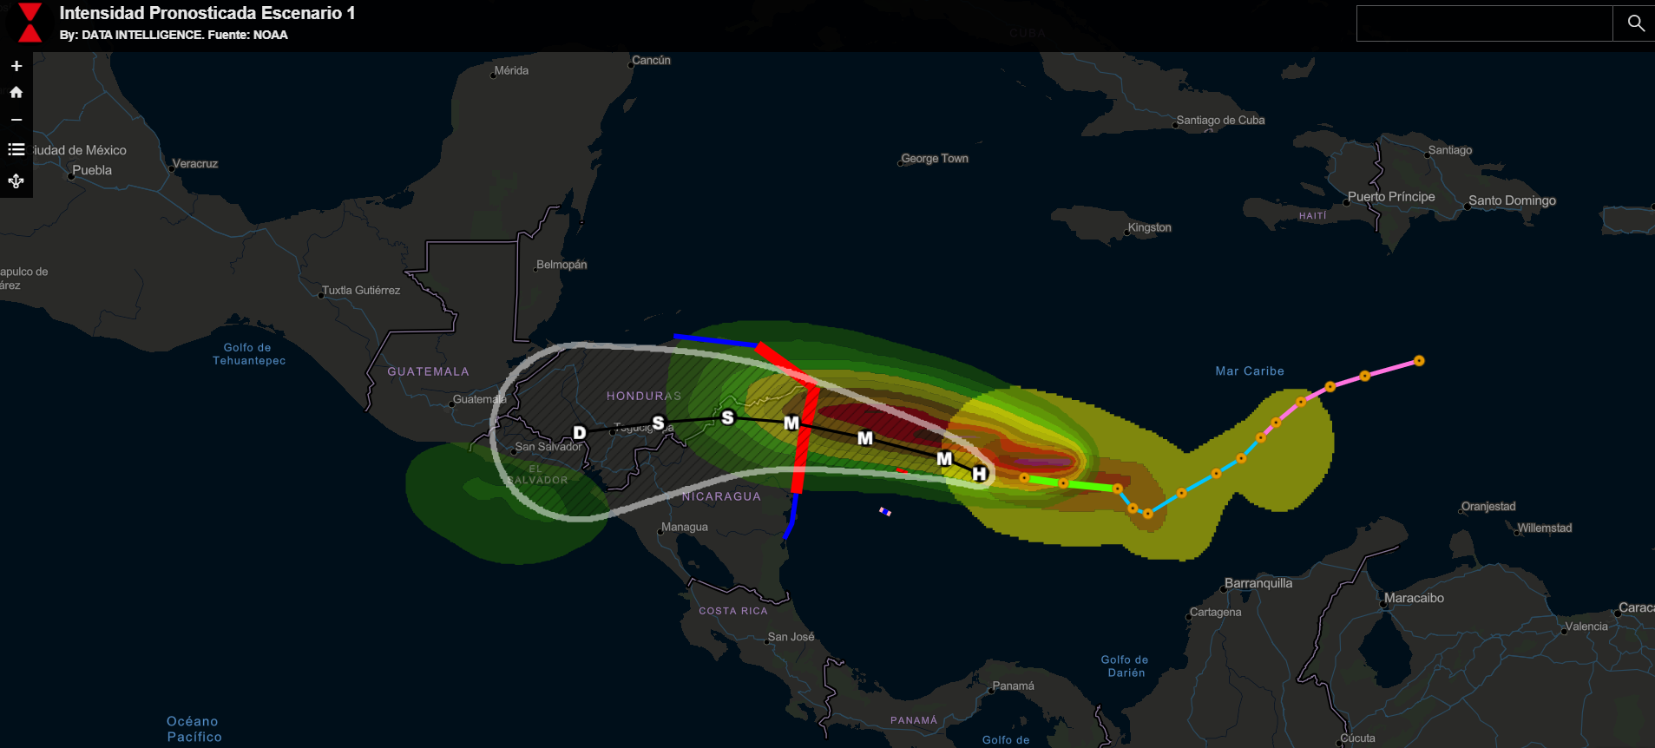
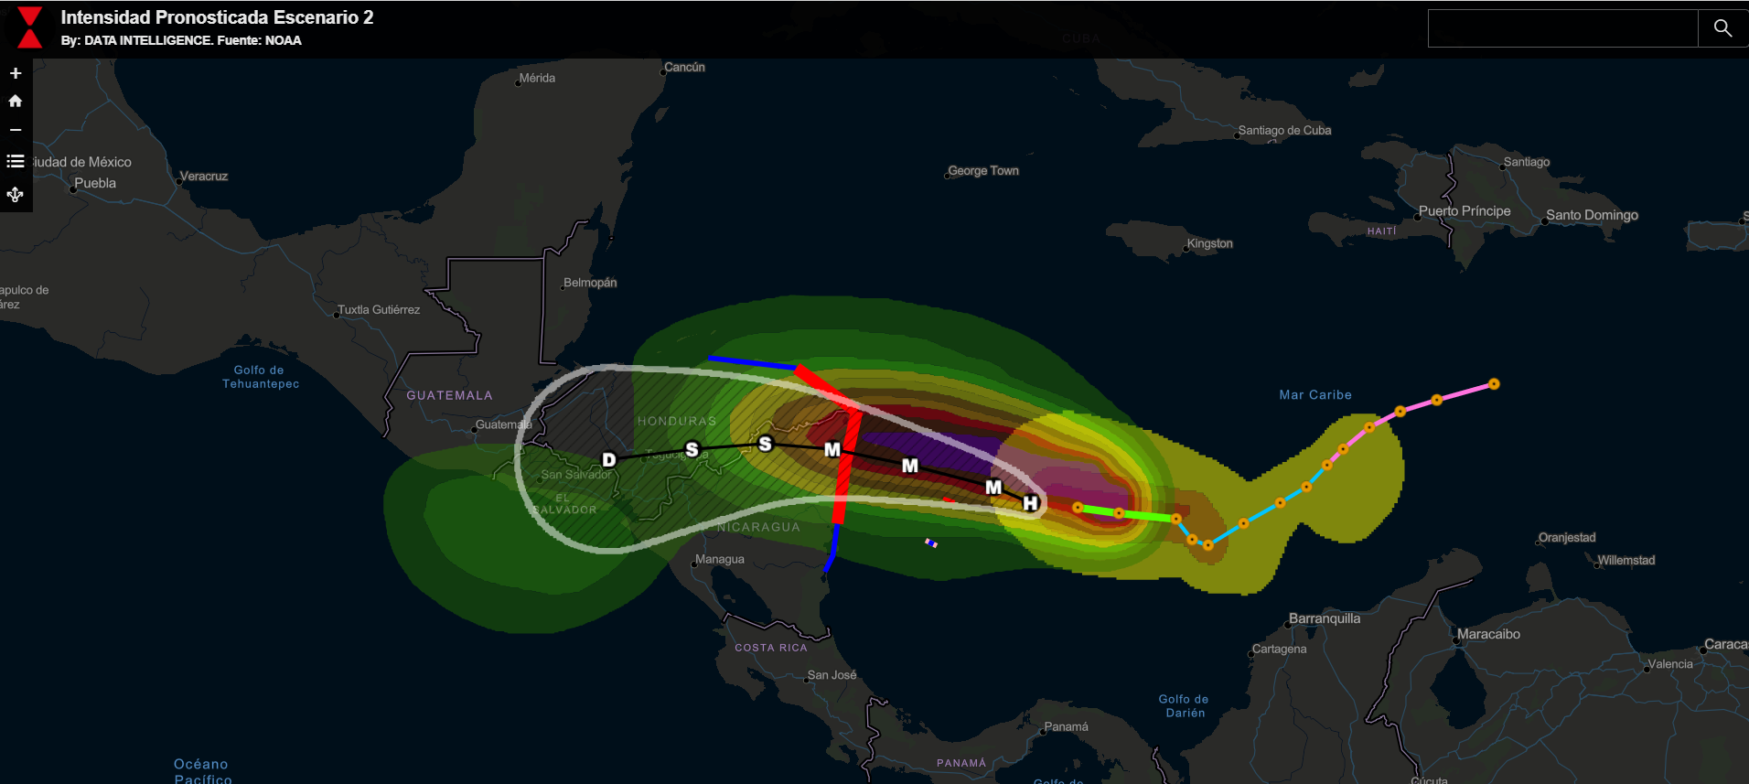
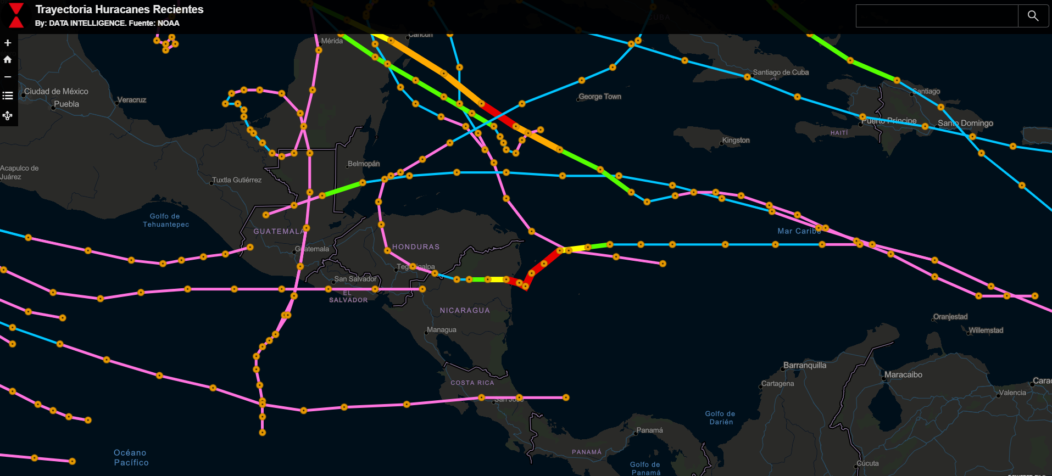

DATA-IMPACTO
Impactos de Eta
Tormentas Activas
Escenario 1 - Iota
Escenario 2 - Iota
Trayectorias
https://app.powerbi.com/view?r=eyJrIjoiYjgzMDc4YWQtMGI0ZC00MTFmLWJlZTgtNTFiOTM0MGViM2FlIiwidCI6IjhmYmFhNWJmLTJlY2MtNGRjOC1iNTZiLThmOTJlMzA3ZjA3NiIsImMiOjR9
https://sud-austral.maps.arcgis.com/apps/View/index.html?appid=83717bd9a9fe4f8b8eec1213d73efcfc&extent=-97.1832,4.6514,-65.5426,21.0419
https://sud-austral.maps.arcgis.com/apps/View/index.html?appid=7a9dbf0dfdaf44cb8062b3c99e56dd17&extent=-98.5840,6.5757,-66.9434,22.8355
https://sud-austral.maps.arcgis.com/apps/View/index.html?appid=c18471c50597435f9d8d56ce1406677e&extent=-98.5840,6.5757,-66.9434,22.8355
https://sud-austral.maps.arcgis.com/apps/View/index.html?appid=8968a78812d644858916532e46c7dec3&extent=-98.9355,6.4229,-67.2949,22.6936

